Slide 1
Module 1: Lesson 2:
Understanding Azure Architectural Components

Slide 2





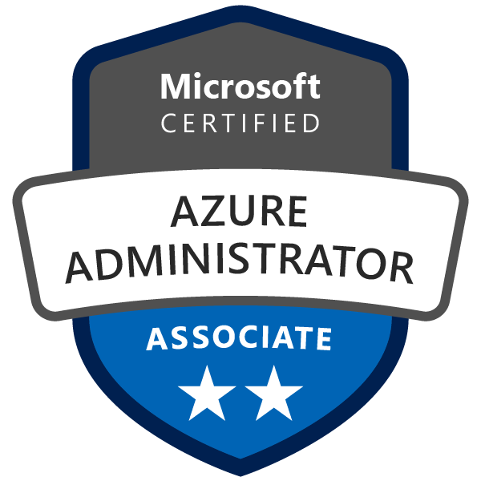

About The Presenter
Sebastien Boinot
Principal DevOps Consultant/ NTT DATA UK. Over 15 years of experience
Azure DevOps Engineer Expert certified
Helped as Azure DevOps consultant many companies from startups to those from CAC40
Microsoft Technologies expert (C# .Net, Azure DevOps, Azure)
Big fan of DevOps, Infra As Code, Agile and Software Craftsmanship
Notes:
How Cloud Can Help DevOps Transformation

Slide 3


Lesson 2: Overview
This lesson will cover
Describe the benefits and usage of Azure regions, region pairs, and availability zones.
Describe the benefits and usage of Azure resources, resource groups, and Azure Resource Manager.
Describe the benefits and usage of Azure subscriptions and management groups.
Notes:
How Cloud Can Help DevOps Transformation

Slide 4
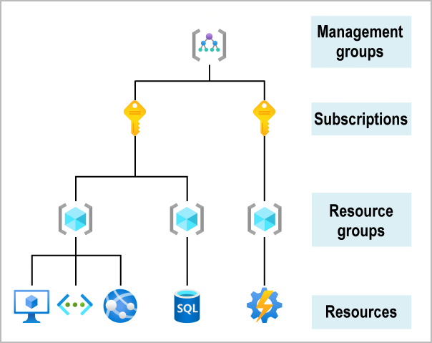
Organizing structure for resources in Azure
Notes:
Having seen the top-down hierarchy of organization, let's describe each of those levels from the bottom up:
Resources: Resources are instances of services that you create, like virtual machines, storage, or SQL databases.
Resource groups: Resources are combined into resource groups, which act as a logical container into which Azure resources like web apps, databases, and storage accounts are deployed and managed.
Subscriptions: A subscription groups together user accounts and the resources that have been created by those user accounts. For each subscription, there are limits or quotas on the amount of resources that you can create and use. Organizations can use subscriptions to manage costs and the resources that are created by users, teams, or projects.
Management groups: These groups help you manage access, policy, and compliance for multiple subscriptions. All subscriptions in a management group automatically inherit the conditions applied to the management group.

Slide 5
Azure regions
A region is an Azure data center within a specific geographic location. All Azure resources are created in an Azure region and subscription
Notes:
When deciding which region(s) to deploy resources in, consider where consumers of the resources are physically located:
Consumers of resources typically want the lowest network latency to their resources. To determine relative latencies between a specified location and Azure regions, see View relative latencies.
Do you have data residency, sovereignty, compliance, or resiliency requirements? If so, choosing the region that aligns to the requirements is critical. For more information, see Azure geographies.
Do you require resiliency across Azure Availability Zones within the same Azure region for the resources you deploy? You can deploy resources, such as virtual machines (VM) to different availability zones within the same virtual network. Not all Azure regions support availability zones however. To learn more about availability zones and the regions that support them, see Availability zones.

Slide 6
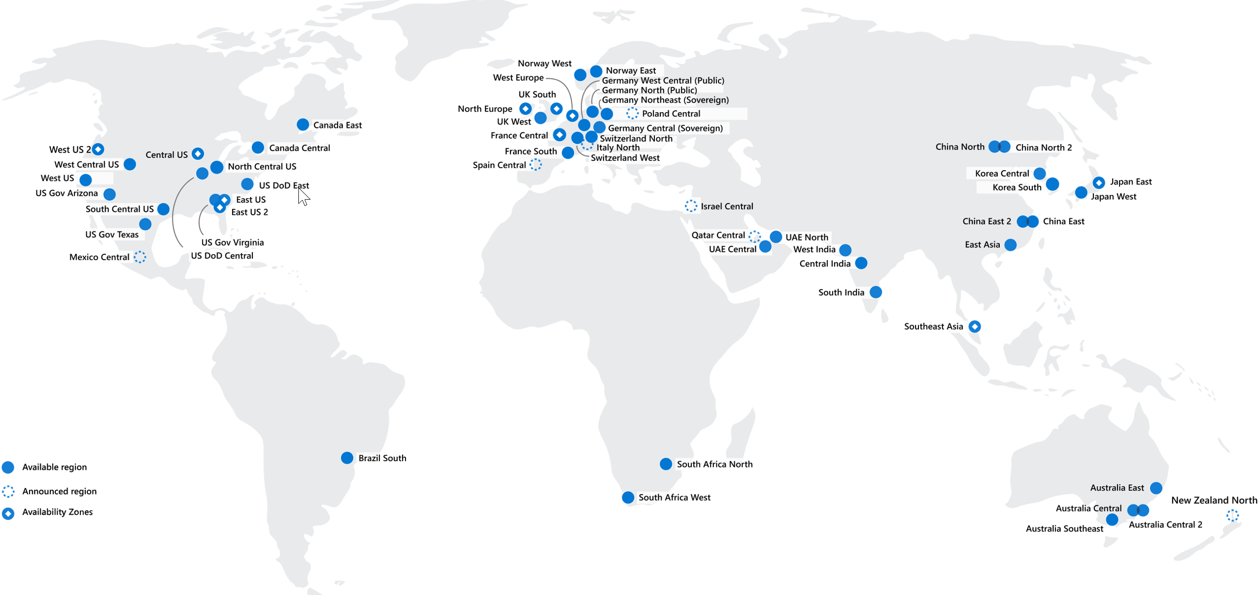
Azure regions
60
regions
worldwide
140
available countries
* Three Azure Government Secret region locations undisclosed
Notes:
Azure has more global regions than any other cloud provider – offering the scale needed to bring apps closer to users around the world, preserving data residency and offering comprehensive compliance and resiliency options for customers.
https://azure.microsoft.com/en-gb/global-infrastructure/regions/
https://map.buildazure.com/ (live map)
https://github.com/buildazure/azure-region-map
Why are regions important?
Azure has more global regions than any other cloud provider. These regions give you the flexibility to bring applications closer to your users no matter where they are. Global regions provide better scalability and redundancy. They also preserve data residency for your services.
Special Azure regions
Azure has specialized regions that you might want to use when you build out your applications for compliance or legal purposes. A few examples include:
US DoD Central, US Gov Virginia, US Gov Iowa and more: These regions are physical and logical network-isolated instances of Azure for U.S. government agencies and partners. These datacenters are operated by screened U.S. personnel and include additional compliance certifications.
China East, China North, and more: These regions are available through a unique partnership between Microsoft and 21Vianet, whereby Microsoft doesn't directly maintain the datacenters.
Regions are what you use to identify the location for your resources. There are two other terms you should also be aware of: geographies and availability zones.

Slide 7



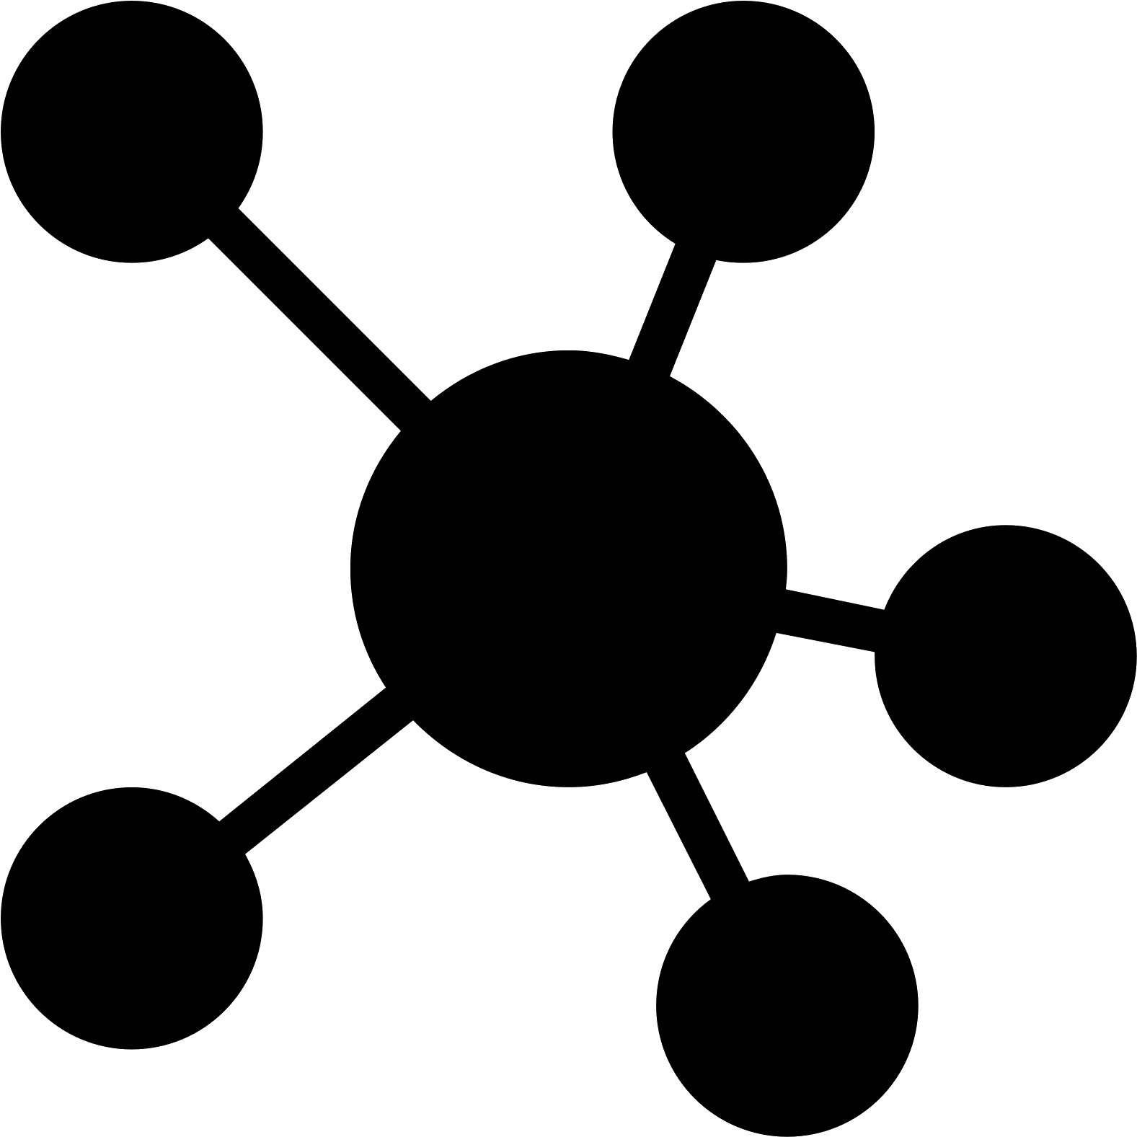
Azure Availability Zones
Fault-isolated locations within an Azure region
Redundant power, cooling, and networking
99.99% SLA on virtual machines
Azure Region
Availability
Zone (1)
Availability
Zone (2)
Availability
Zone (3)
Notes:
Azure availability zones
You want to ensure your services and data are redundant so you can protect your information in case of failure. When you host your infrastructure, setting up your own redundancy requires that you create duplicate hardware environments. Azure can help make your app highly available through availability zones.
What is an availability zone?
Availability zones are physically separate datacenters within an Azure region. Each availability zone is made up of one or more datacenters equipped with independent power, cooling, and networking. An availability zone is set up to be an isolation boundary. If one zone goes down, the other continues working. Availability zones are connected through high-speed, private fiber-optic networks.
Use availability zones in your apps
You can use availability zones to run mission-critical applications and build high-availability into your application architecture by co-locating your compute, storage, networking, and data resources within a zone and replicating in other zones. Keep in mind that there could be a cost to duplicating your services and transferring data between zones.
Availability zones are primarily for VMs, managed disks, load balancers, and SQL databases. Azure services that support availability zones fall into three categories:
Zonal services: You pin the resource to a specific zone (for example, VMs, managed disks, IP addresses).
Zone-redundant services: The platform replicates automatically across zones (for example, zone-redundant storage, SQL Database).
Non-regional services: Services are always available from Azure geographies and are resilient to zone-wide outages as well as region-wide outages.
Check the documentation to determine which elements of your architecture you can associate with an availability zone.

Slide 8
Region pair
Geography
Each Azure region is always paired with another region within the same geography at least 300 miles away.
That helps reduce the interruptions due to events such as natural disasters, civil unrest, power outages.
Region pair
Azure Region
Azure Region
Availability
Zone (1)
Availability
Zone (2)
Availability
Zone (1)
Availability
Zone (2)
Availability
Zone (3)
Availability
Zone (3)
Region pair
Azure Region
Azure Region
Availability
Zone (1)
Availability
Zone (2)
Availability
Zone (1)
Availability
Zone (2)
Availability
Zone (3)
Availability
Zone (3)
Notes:
If a region in a pair was affected by a natural disaster, for instance, services would automatically fail over to the other region in its region pair.
E.g. West US paired with East US, and SouthEast Asia paired with East Asia.
Azure region pairs
Availability zones are created by using one or more datacenters. There's a minimum of three zones within a single region. It's possible that a large disaster could cause an outage big enough to affect even two datacenters. That's why Azure also creates region pairs.
What is a region pair?
Each Azure region is always paired with another region within the same geography (such as US, Europe, or Asia) at least 300 miles away. This approach allows for the replication of resources (such as VM storage) across a geography that helps reduce the likelihood of interruptions because of events such as natural disasters, civil unrest, power outages, or physical network outages that affect both regions at once. If a region in a pair was affected by a natural disaster, for instance, services would automatically failover to the other region in its region pair.
Examples of region pairs in Azure are West US paired with East US and SouthEast Asia paired with East Asia.
Because the pair of regions is directly connected and far enough apart to be isolated from regional disasters, you can use them to provide reliable services and data redundancy. Some services offer automatic geo-redundant storage by using region pairs.
Additional advantages of region pairs:
If an extensive Azure outage occurs, one region out of every pair is prioritized to make sure at least one is restored as quickly as possible for applications hosted in that region pair.
Planned Azure updates are rolled out to paired regions one region at a time to minimize downtime and risk of application outage.
Data continues to reside within the same geography as its pair (except for Brazil South) for tax- and law-enforcement jurisdiction purposes.
Having a broadly distributed set of datacenters allows Azure to provide a high guarantee of availability.

Slide 9

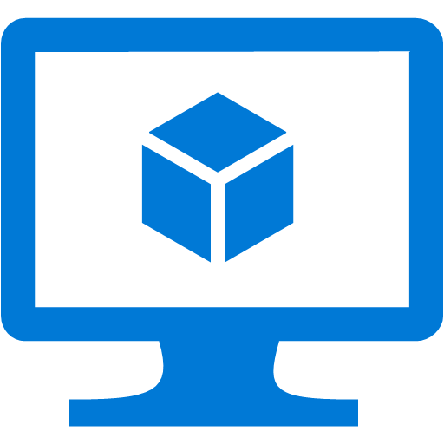


Azure Resources
Azure Resource is a manageable item available through Azure. VMs, web apps, databases, etc.
VM
Storage Account
Virtual Network
Web App
DB
And more…

Slide 10





Resource Group is a Container for Azure Resources
A Resource Group is a logical container into which Azure resources like web apps, databases, and storage accounts are deployed and managed.
For example, you can choose to delete the entire resource group in one simple step later
You decide how to allocate resources to groups
Web App
DB
Storage Account
Virtual Network
VM
Resource Group
Notes:
All resources must be in a resource group and a resource can only be a member of a single resource group.
https://docs.microsoft.com/en-us/azure/azure-resource-manager/management/overview#resource-groups

Slide 11

Resource Groups Allows Managing Resources
Tightly coupled containers of multiple resources of similar or different types
Every resource *must* exist in one and only one resource group
Resource groups can span regions
RESOU
R
CE G
R
OUP
Notes:
You can deploy, manage, and monitor all of the resources for your solution as a group, known as a resource group, rather than handle these resources individually.
Each resource can only exist in one resource group at a time.

Slide 12
Resource Group Lifecycle
Question:
Should these resources be in the same group or a different one?
VM
Storage Account
Web App
Hint:
Do they have common lifecycle and management?
(VM, Storage, Web) in one Resource Group
Answer:
Up to you.
VM
Storage Account
Web App
VM in RG
Storage in RG
Web in RG
Notes:
All the resources in your group should share the same lifecycle. You will deploy, update, and delete them together. If one resource, such as a database server, needs to exist on a different deployment cycle, it should be in another resource group.
You can add or remove a resource to a resource group at any time.
You can move a resource from one resource group to another group.
A resource group can contain resources that reside in different regions.
A resource group can be used to scope access control for administrative actions.
A resource can be linked to a resource in another resource group when the two resources must interact with each other, but they do not share the same lifecycle (for example, multiple apps connecting to a database).

Slide 13


Different Organization for Resource Groups
vnet-rg
db-rg
vm-rg
dev-rg
qa-rg
prod-rg
finance-rg
hr-rg
marketing-rg

Slide 14
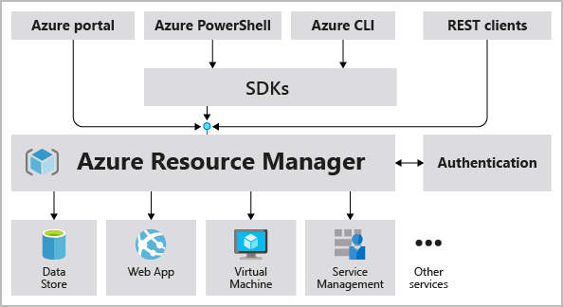
Azure Resource Manager
Notes:
Azure Resource Manager
Azure Resource Manager is the deployment and management service for Azure. It provides a management layer that enables you to create, update, and delete resources in your Azure account. You use management features like access control, locks, and tags to secure and organize your resources after deployment.
When a user sends a request from any of the Azure tools, APIs, or SDKs, Resource Manager receives the request. It authenticates and authorizes the request. Resource Manager sends the request to the Azure service, which takes the requested action. Because all requests are handled through the same API, you see consistent results and capabilities in all the different tools.
The following image shows the role Resource Manager plays in handling Azure requests.
All capabilities that are available in the Azure portal are also available through PowerShell, the Azure CLI, REST APIs, and client SDKs. Functionality initially released through APIs will be represented in the portal within 180 days of initial release.
The benefits of using Resource Manager
With Resource Manager, you can:
Manage your infrastructure through declarative templates rather than scripts. A Resource Manager template is a JSON file that defines what you want to deploy to Azure.
Deploy, manage, and monitor all the resources for your solution as a group, rather than handling these resources individually.
Redeploy your solution throughout the development life cycle and have confidence your resources are deployed in a consistent state.
Define the dependencies between resources so they're deployed in the correct order.
Apply access control to all services because RBAC is natively integrated into the management platform.
Apply tags to resources to logically organize all the resources in your subscription.
Clarify your organization's billing by viewing costs for a group of resources that share the same tag.

Slide 15

Azure Subscription
An Azure subscription is a logical container used to provision resources in Azure.
It holds the details of all your resources like virtual machines (VMs), databases, and more.
Notes:
Azure subscriptions
Using Azure requires an Azure subscription. A subscription provides you with authenticated and authorized access to Azure products and services. It also allows you to provision resources. An Azure subscription is a logical unit of Azure services that links to an Azure account, which is an identity in Azure Active Directory (Azure AD) or in a directory that Azure AD trusts.

Slide 16
Create Additional Azure Subscriptions
Environments: When managing resources, you can choose to create subscriptions to set up separate environments for development and testing, security, or to isolate data for compliance reasons.
Organizational structures: You can create subscriptions to reflect different organizational structures.
Billing: You might want to also create additional subscriptions for billing purposes. Because costs are first aggregated at the subscription level
Subscription limits: Subscriptions are bound to some hard limitations. For example, the maximum number of Express Route circuits per subscription is 10
Notes:
Azure subscriptions
Using Azure requires an Azure subscription. A subscription provides you with authenticated and authorized access to Azure products and services. It also allows you to provision resources. An Azure subscription is a logical unit of Azure services that links to an Azure account, which is an identity in Azure Active Directory (Azure AD) or in a directory that Azure AD trusts.

Slide 17
Resources, Resource Groups and Subscriptions
Subscription
Resource Group
Resource Group
Resource Group

Slide 18
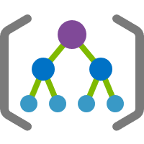
Azure Management Groups
Azure Management Groups a way to efficiently manage access, policies, and compliance for several Azure subscriptions.
Notes:
Azure management groups
If your organization has many subscriptions, you might need a way to efficiently manage access, policies, and compliance for those subscriptions. Azure management groups provide a level of scope above subscriptions. You organize subscriptions into containers called management groups and apply your governance conditions to the management groups. All subscriptions within a management group automatically inherit the conditions applied to the management group. Management groups give you enterprise-grade management at a large scale no matter what type of subscriptions you might have. All subscriptions within a single management group must trust the same Azure AD tenant.
For example, you can apply policies to a management group that limits the regions available for VM creation. This policy would be applied to all management groups, subscriptions, and resources under that management group by only allowing VMs to be created in that region.

Slide 19

Azure Management Groups
Root Management Group
Management Group
Subscription
HR
IT
Marketing
EA Subscription
EA Subscription
Resource Group
Resource
Free Trial Subscription
Free Trial Subscription
Notes:
Hierarchy of management groups and subscriptions
You can build a flexible structure of management groups and subscriptions to organize your resources into a hierarchy for unified policy and access management. The following diagram shows an example of creating a hierarchy for governance by using management groups.
You can create a hierarchy that applies a policy. For example, you could limit VM locations to the US West Region in a group called Production. This policy will inherit onto all the Enterprise Agreement subscriptions that are descendants of that management group and will apply to all VMs under those subscriptions. This security policy can't be altered by the resource or subscription owner, which allows for improved governance.
Another scenario where you would use management groups is to provide user access to multiple subscriptions. By moving multiple subscriptions under that management group, you can create one role-based access control (RBAC) assignment on the management group, which will inherit that access to all the subscriptions. One assignment on the management group can enable users to have access to everything they need instead of scripting RBAC over different subscriptions.
Important facts about management groups
10,000 management groups can be supported in a single directory.
A management group tree can support up to six levels of depth. This limit doesn't include the root level or the subscription level.
Each management group and subscription can support only one parent.
Each management group can have many children.
All subscriptions and management groups are within a single hierarchy in each directory.

Slide 20




Prepare for The Exam (Q/A)
1. Which of the following can be used to manage governance across multiple Azure subscriptions?
Azure initiatives
Resource groups
Management groups
2. Which of the following is a logical unit of Azure services that links to an Azure account?
Resource group
Azure subscription
Management group

Slide 21
Prepare for The Exam (Q/A)
3. Which of the following features does not apply to resource groups?
Resources can be in only one resource group.
Role-based access control can be applied to the resource group.
Resource groups can be nested.
4. Which of the following statements is a valid statement about an Azure subscription?
Using Azure doesn't require a subscription.
An Azure subscription is a logical unit of Azure services.

Slide 22

Summary
This lesson has covered
The concepts and terminology for several of the core Azure architecture components.
The benefits and usage of Azure regions, region pairs, and availability zones.
The benefits and usage of Azure resources, resource groups, and Azure Resource Manager.
The benefits and usage of Azure subscriptions and management groups.
Notes:
How Cloud Can Help DevOps Transformation

Slide 23
Summary
Next Lesson:
(3) Introduction to Azure compute Services and Virtual Machine VS. App Service
Notes:
How Cloud Can Help DevOps Transformation

